Slide 1

UPI Fraud Analytics using AWS Athena & Power BI
Detecting fraudulent behavior in UPI transactions and identifying high-risk patterns using AWS cloud infrastructure and advanced analytics.

Slide 2

Project Goals & Objectives
Fraud Shift Patterns
High-Risk Senders
Understand how fraud tactics evolve over time.
Identify repeat fraudulent UPI accounts.
Fraud Concentration
Real-Time Monitoring
Analyze which fraud types dominate.
Build foundation for proactive detection.

Slide 3

Dataset & Architecture Overview
Dataset Summary
AWS Cloud Stack
10,000 synthetic transactions
S3: Raw transaction storage
619 confirmed fraud cases
Glue: ETL & schema detection
4 fraud types tracked
Athena: SQL fraud analysis
Key metrics: amount, payment type, sender/receiver UPI
Power BI: Interactive dashboards

Slide 4

6.19%
Overall Fraud Exposure Rate
619 fraudulent transactions out of 10,000 total transactions. This baseline establishes the fraud risk landscape for UPI payments and guides detection thresholds.

Slide 5
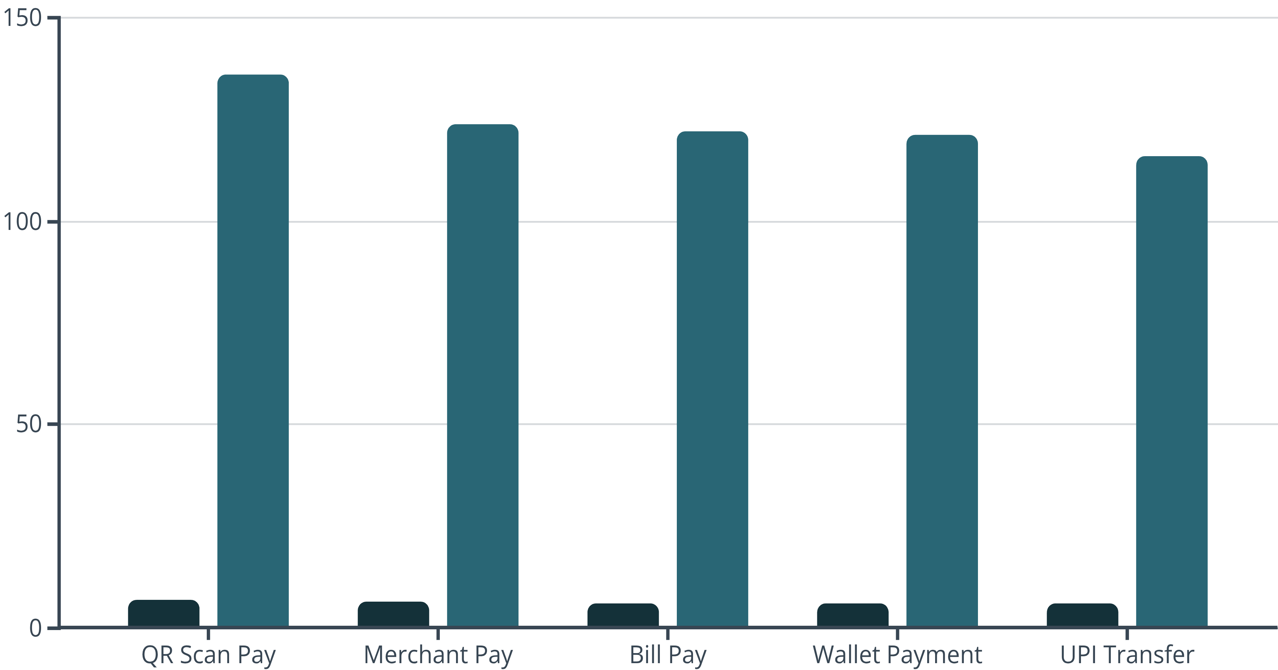
Most Vulnerable Payment Methods
Fraud Rate %
Fraud Count
QR Scan Pay shows highest fraud penetration at 6.66%, followed by Merchant Pay at 6.41%. These channels require enhanced security protocols.

Slide 6








Fraud Type Distribution
Account Takeover
Social Engineering
161 cases
161 cases
Fake Merchant
Micro Velocity
140 cases
157 cases
Account Takeover and Social Engineering dominate fraud patterns. Micro Velocity fraud indicates bot-based automation attempts.

Slide 7

Financial Impact Analysis
₹24,981
₹15.5M
₹24,938
Avg Fraud Loss
Total Exposure
Normal Avg Amount
Per fraudulent transaction
619 fraud cases × avg loss
Fraud and normal transactions similar in value

Slide 8

Repeat Attacker Patterns
Analysis reveals concentrated fraud from specific sender UPI accounts. Top 10 fraudulent senders each show 100% fraud rate on their transactions, indicating targeted repeat attacks rather than random fraud attempts.
Repeat Attack Pattern
Clustering Behavior
Detection Opportunity
Fraudsters reuse same UPI IDs for multiple transactions, enabling pattern-based detection.
Fraud concentrated to specific sender accounts suggests organized fraud rings.
Sender UPI ID blacklisting can prevent future attacks from known fraudsters.

Slide 9

Security & Access Controls
IAM Access Control
Limiting data access to authorized personnel only.
No Public Exposure
Zero public endpoint access to sensitive data.
ODBC Role Mapping
Athena connections secured through role-based authentication.
Least Privilege
Minimal permissions granted per user role.

Slide 10

Key Takeaways & Next Steps
1
Implement Real-Time Monitoring
Deploy streaming fraud detection using identified patterns for immediate threat response.
2
Strengthen QR & Merchant Channels
Enhanced security for highest-risk payment methods (6.66% and 6.41% fraud rates).
3
Blacklist Repeat Offenders
Block known fraudulent UPI accounts to prevent recurring attacks.
4
Expand Analytics Foundation
Build on current AWS infrastructure for continuous fraud pattern evolution tracking.

